Slide 1
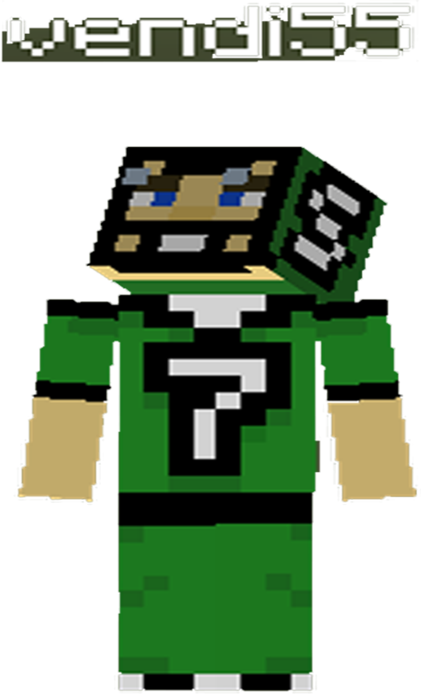
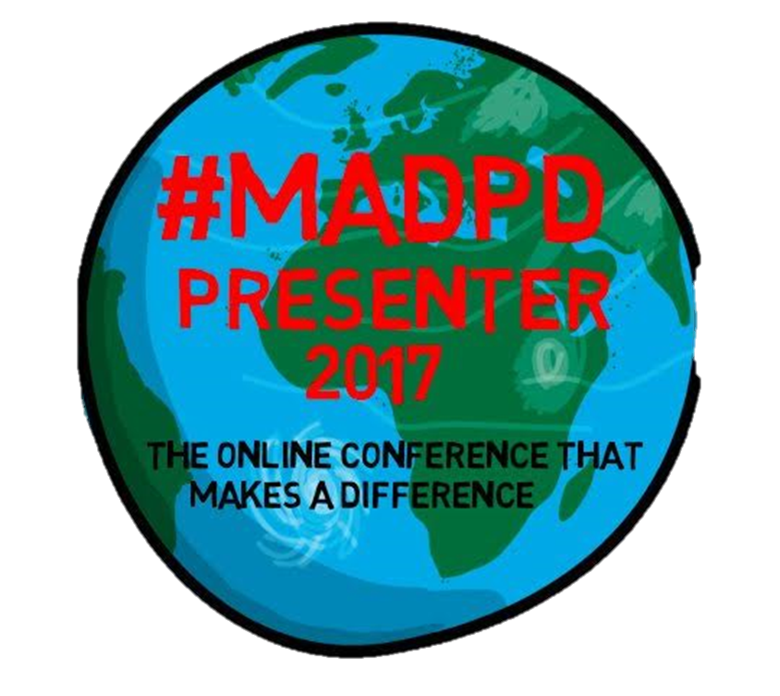
Minecraft In The Math Classroom
Dean Vendramin
@vendi55
d.Vendramin@rcsd.ca
deanvendramin.weebly.com

Slide 2
Minecraft In The Math Classroom
My Inspiration

Slide 3
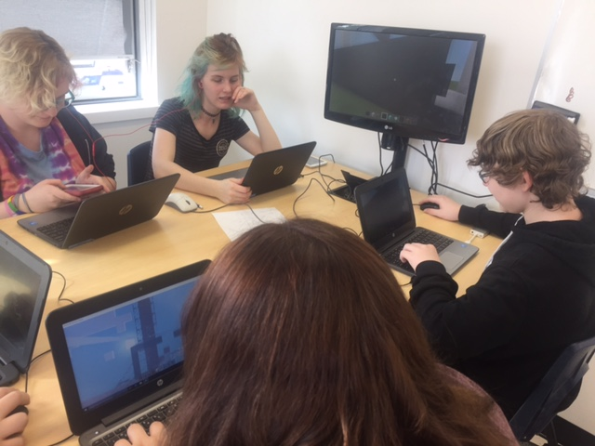
Minecraft In The Math Classroom
My Journey

Slide 4
Presentation Line Up
Why I Use Minecraft as a Tool
Examples of How I Use Minecraft I My Math Classroom
Resources / Articles
How To Play
What Education/Research Is Saying
What Students Are Saying
Special Guest
Wrap Up

Slide 5
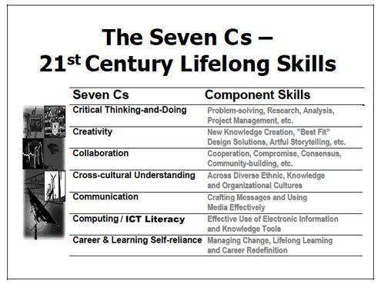
21st Century Skills

Slide 6
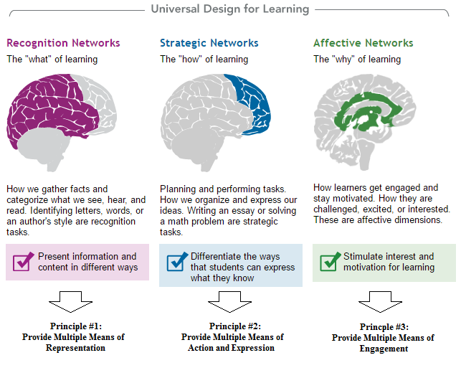
21st Century Skills

Slide 7
How I Use Minecraft In The Math Classroom

Slide 8
How I Use Minecraft In The Math Classroom - Scale
Lesson Plan
Demo
Student Project

Slide 9
How I Use Minecraft In The Math Classroom - Symmetry
Lesson Plan
Demo
Student Project

Slide 10
How I Use Minecraft In The Math Classroom – Surface Area
Lesson Plan
Demo
Student Project

Slide 11
How I Use Minecraft In The Math Classroom – Slope
Lesson Plan
Demo
Student Projects

Slide 12
How I Use Minecraft In The Math Classroom – Surface Area & Volume
Lesson Plan
Demo
Student Project

Slide 13
How I Use Minecraft In The Math Classroom – Trig and Scale
Lesson Plan
Demo
Example

Slide 14
How I Use Minecraft In The Math Classroom – Math Tasks
Math Tasks

Slide 15
How I Use Minecraft In Other Classrooms
Genius Hour
Science Project
Next – Coding?

Slide 16
Resources
https://education.minecraft.net
http://deanvendramin.weebly.com/minecraft-in-the-classroom.html

Slide 17
Articles
http://www.edtechmagazine.com/k12/article/2017/03/educators-shape-minecraft-s-growing-presence-classroom
https://simonbaddeley64.wordpress.com/2017/03/31/assessing-the-curriculum-with-minecraft-education-edition/
https://www.teachingchannel.org/blog/2017/04/13/teaching-learning-minecraft/?platform=hootsuite

Slide 18
How to Play
http://minecraft.gamepedia.com/Tutorials/Beginner%27s_guide
http://www.minecraft101.net/g/getting-started.html
https://www.planetminecraft.com/

Slide 19
Pedagogy / Tips
Background Information
(Sway with Useful Pedagogy
(Papert) and Game Play Info)

Slide 20
Pedagogy / Tips
"GAME-BASED LEARNING FITS IN VERY WELL WITH
MEETING STUDENTS WHERE THEY ARE. THEY'RE
PLAYING GAMES AT HOME, USING DIGITAL DEVICES,
AND NAVIGATING VIRTUAL WORLDS, SO THEY'RE
ALREADY VERY FAMILIAR WITH THIS."
Steven Messner

Slide 21
Pedagogy / Tips
THE MOST IMPORTANT TIP I CAN GIVE YOU IS STAY
OUT OF THE WAY AND LET STUDENTS DRIVE THE
CLASS, RATHER THAN STRICTLY FOLLOWING YOUR
SET PLANS. KIDS NEED TIME TO PLAY, EXPLORE,
INQUIRE AND CREATE THEIR LONG-TERM DESIGN
PROJECTS.
Pike and Lamb

Slide 22
Pedagogy / Tips
NOT TO BE CONFUSED WITH GAMIFICATION, GAME
BASED LEARNING (GBL) IS THE PROCESS OF USING
GAMES TO ACHIEVE A DEFINED SET OF LEARNING
OUTCOMES.
Steven Johnson

Slide 23
Pedagogy / Tips
DON’T TELL MY KIDS, BUT MINECRAFT IS A
MATHEMATICAL GAME. IF YOU HAVE ANY DOUBTS, A
QUICK GLANCE WILL CONFIRM THIS. THE GAME CAN
HELP DEVELOP OR DEEPEN A CHILD’S SPACIAL
AWARENESS AND SKILLS. BUILDING AND CREATING WITH
MINECRAFT REQUIRES A SOLID GRASP OF SYMMETRY.
Amy Landisman

Slide 24
Pedagogy / Tips
"MINECRAFT IS USEFUL IN THE CLASSROOM BECAUSE
YOU CAN USE IT FOR PRETTY MUCH ANYTHING YOU
WANT," THALKAR SAID. "THAT’S THE BEAUTY OF THE WAY
THE GAME WAS DESIGNED AND HOW OPEN ENDED IT IS. IF
YOU WANT TO USE IT FOR SOMETHING FOR MATH OR FOR
SCIENCE YOU CAN, EITHER JUST BY USING THE GAME
ITSELF OR BY MODIFYING IT."
Anthony Perez

Slide 25
Pedagogy / Tips
Work Place Math 20 (16-17 year olds) Minecraft Comments and Tips
Use Minecraft because it allows students to be more creative. Santana A
Need to be creative and come up with solutions for limitations. Jeff N
Helps visualize math concepts. Ashley S / Taylor C
Let students try things on their own within the learning goal. Cody S
Use as a different alternative to enjoy learning. Troy D
Helps with giving a visual aid to represent to understand 3d objects. Renz D
Give it a try. Luke S
You can learn from Minecraft. Jacob G
It cools. Like to work collaboratively and share the work.
Taylor EI

Slide 26
Pedagogy / Tips
Math 9 (13-14 Year olds) Students Minecraft Comments and Tips
Helps one visual the math and enjoy learning. Like when teachers join our worlds to play and check out our work. Krisel M
Make a 2D drawing come to life in a 3D world. Give students a chance to play. Christina T
I’d like to see teachers use Minecraft more. Allows for an interactive sense of learning rather than just copy notes. Jaiden H.
“Don’t be discouraged to use Minecraft as tool just because it may appear to be ‘childish’”. Neil S
Sometime can be distracting but other times helps me. Emily W
Play a bit yourself and have a general idea of how to use it, but don’t have to know everything. Emily W
Minecraft is good for the classroom because it can be used to understand math concepts such as surface area, symmetry. Also good for doing in class projects and give students a better understanding and see the big picture. Joseph D
Learn the game first just to get used to it. Jan D
Its good for combining math, art, and graphic design. Helps students learn.
Jessica G

Slide 27
Pedagogy / Tips
Minecraft Tips from Students
Mess with Redstone and see what happens.
Use flat world to start then there is more creating and less digging.
If you want to make something move you need Redstone to make automatic doors and rails.
Use certain colour blocks when making as reference points.
Do not start in creative mode you can switch to creative after using commands (won’t have access to TNT right away and you can control what student gets what).
signs helps leave tips and info as reminders of tasks to get done.
Torches create temporary air pockets underwater...
Torches break stacks of sand and gravel...
Torches can hold up sand and gravel...
You can build off of torches...
Signs and ladders stop water and lava...
Blazes hate snowballs...
Soul Sand makes you sink...
In creative mode, middle click gives you the object you're looking at…
Cooked steak regens the most hunger…
When you first spawn into a world, mine coal, cobblestone, and wood…
Never dig straight down!!!
Always have a sword equipped when walking around a cave…
Build a house near a river, a cave and a forest…
Pressing ctrl and w will make you sprint…
Wheat attracts cows, and sheep…
You won’t lose hunger in peaceful mode…
Water flows 7 blocks, but lava flows 6…
Never sleep in the nether…

Slide 28
Build Battle
Fun Way to Engage
Struggle is Good
Creativity Counts
Each side is 1m
Get Ready For A Build Battle

Slide 29
Build Battle #1 – Surface Area
You will have 5 minutes to construct an object with a surface area of
25m²

Slide 30
Build Battle #2 – Surface Area
You will have 5 minutes to construct an object with a surface area of
50m²

Slide 31
Build Battle #3 – Symmetry
You will have 5 minutes to construct an a symmetrical pattern and indicate type or types of symmetry.

Slide 32
PD Opportunities
Microsoft Education
Microsoft Innovative Expert -
https://education.microsoft.com
Code for Points - DVOJT2HOTH90FY2017
Apple Teacher
https://www.apple.com/ca/education/apple-teacher/

Slide 33
Minecraft In The Math Classroom
Dean Vendramin
@vendi55
d.Vendramin@rcsd.ca
deanvendramin.weebly.com

